Slide 1

JBIG
SEMINAR
딥러닝 팀

Slide 2
JBIG
CONTENTS
SEMINAR
01. Project interim findings
02. Sample model (SENet)
03. Experiment Analysis
04. Additional Analysis Technique (CAM)

Slide 3
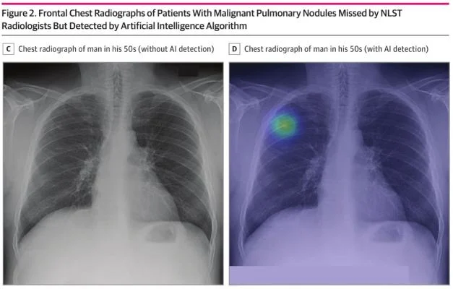
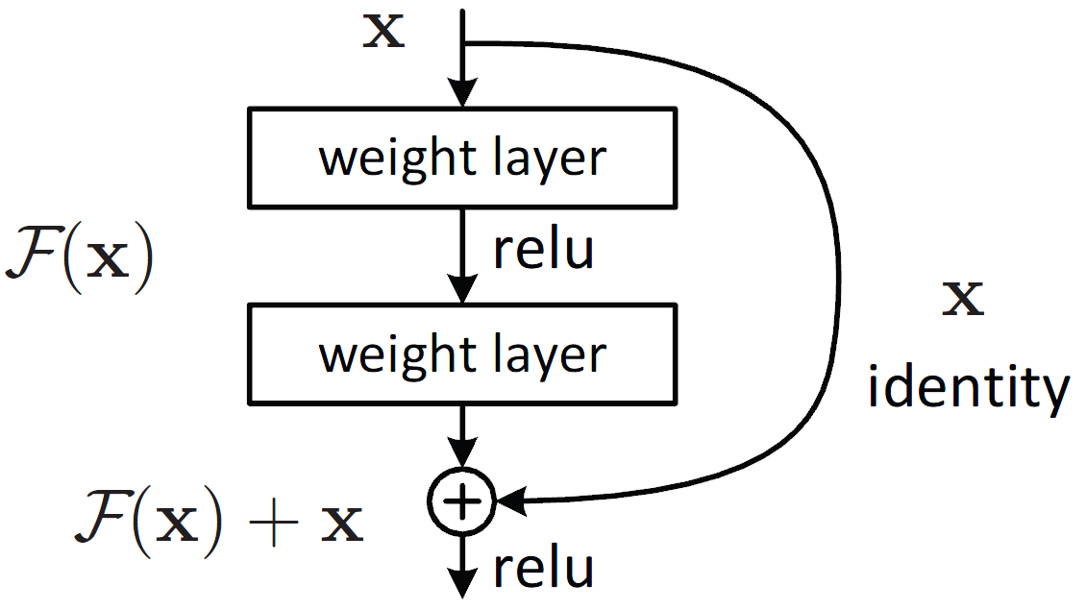
01
Project interim findings
SEMINAR
Purpose : Predict lung image into ResNet 50 model

Slide 4
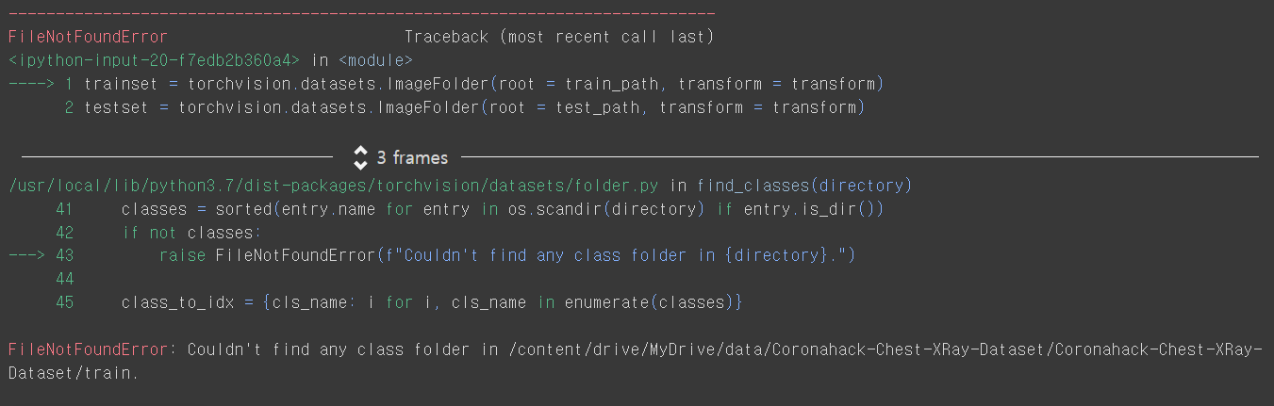
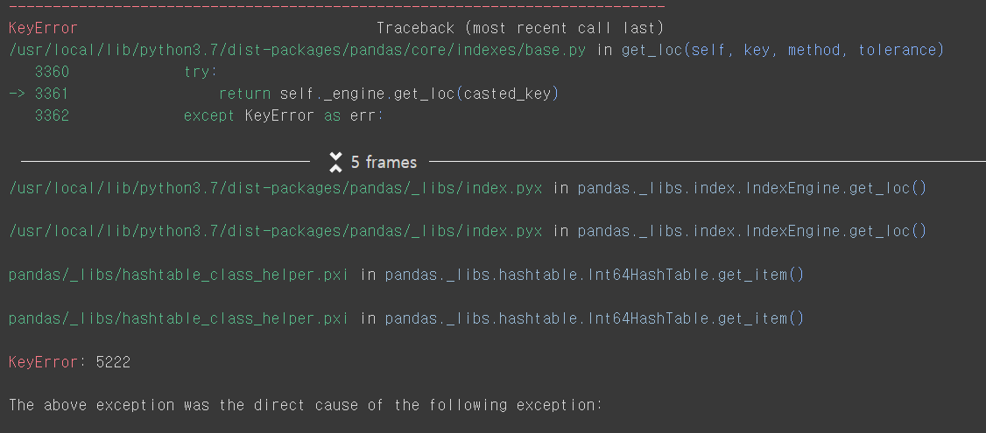


01
Project interim findings
Error
SEMINAR
Now,,,
Error
Error
Error
Error
Me
My studymates

Slide 5
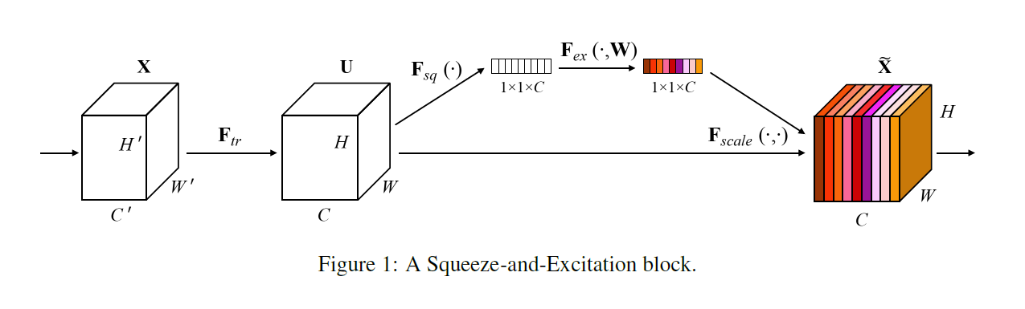
02
Sample model (SENet)
SEMINAR
SE : Squeeze and Excitation
Paper URL

Slide 6
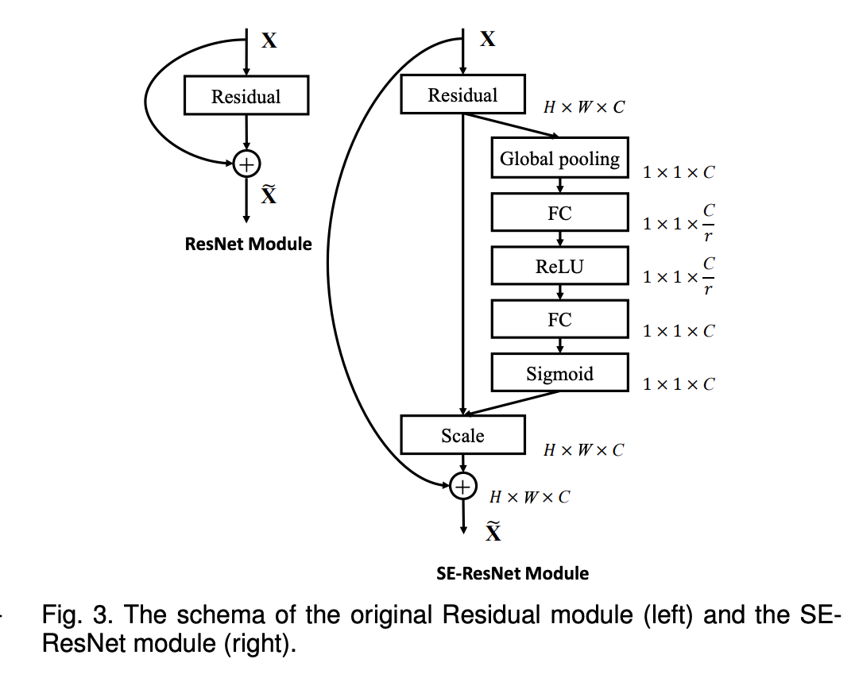
02
Sample model (SENet)
SEMINAR
ResNet + SE Block version (SE – Resenet module)

Slide 7
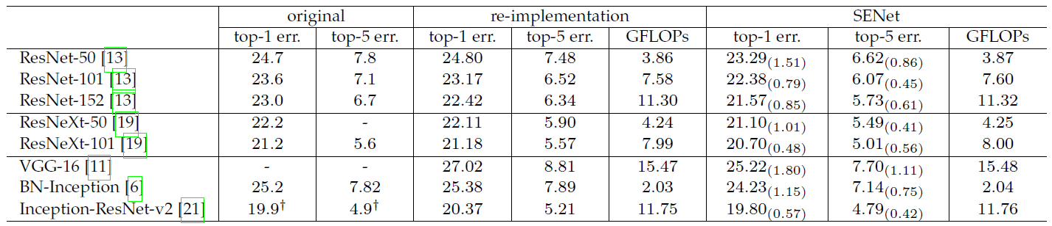
02
Sample model (SENet)
SEMINAR
Error rates comparison

Slide 8
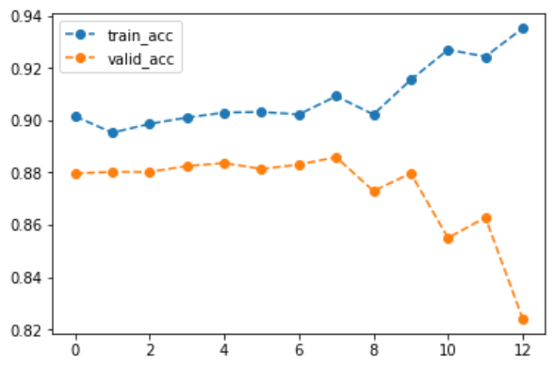
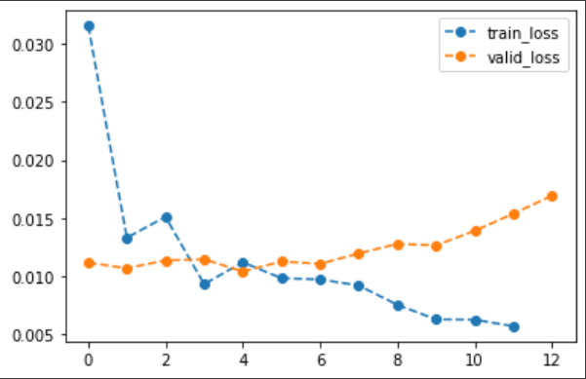
03
Experiment Analysis
SEMINAR
ACC
Error
Overfitting Occurred!!

Slide 9
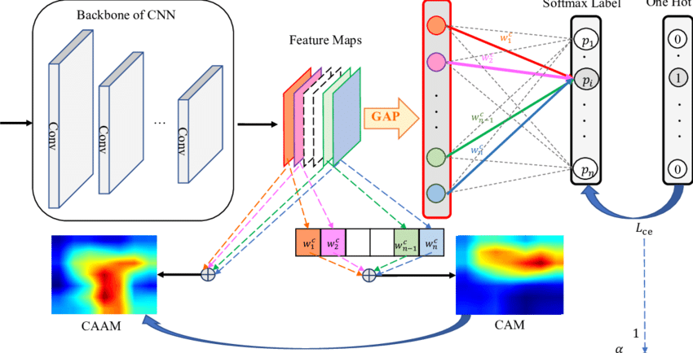
04
Additional Analysis Technique (CAM)
SEMINAR
Class Activation Map

Slide 10
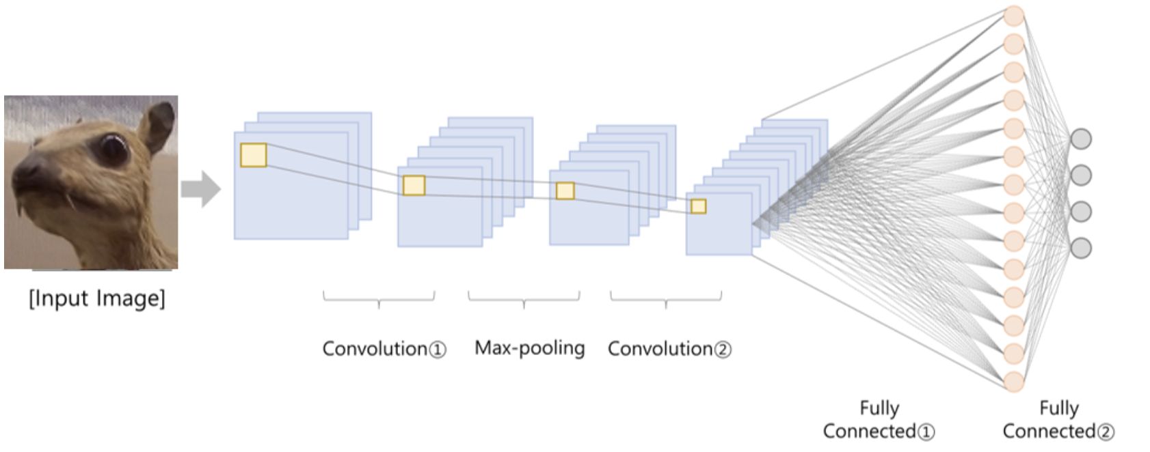
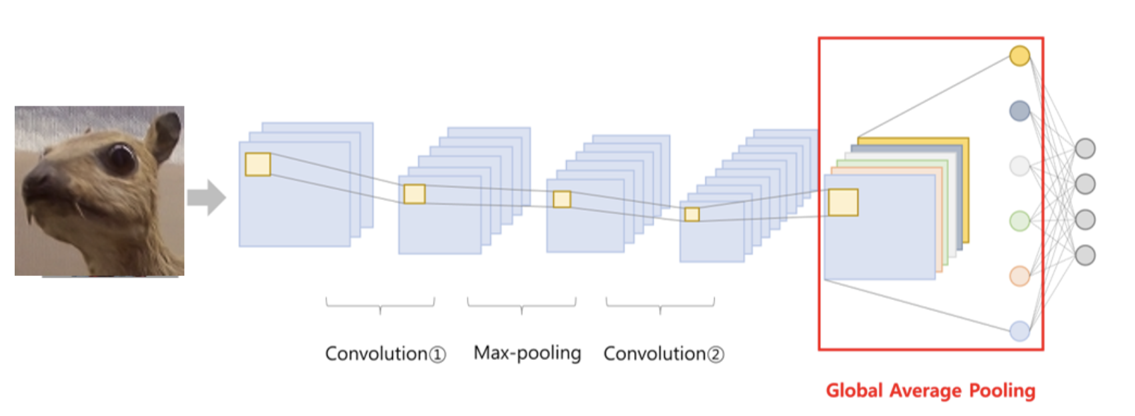
04
Additional Analysis Technique (CAM)
SEMINAR
GAP : Global Average Pooling

Slide 11
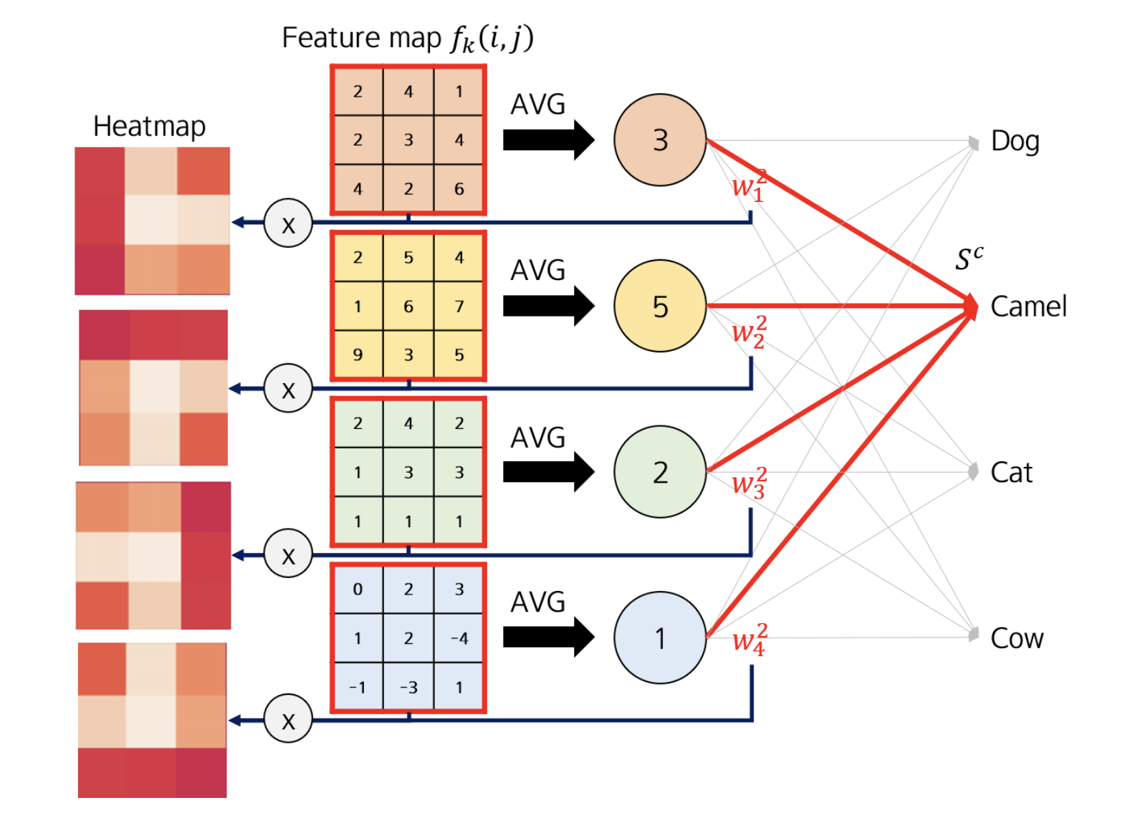
04
Additional Analysis Technique (CAM)
SEMINAR

Slide 12
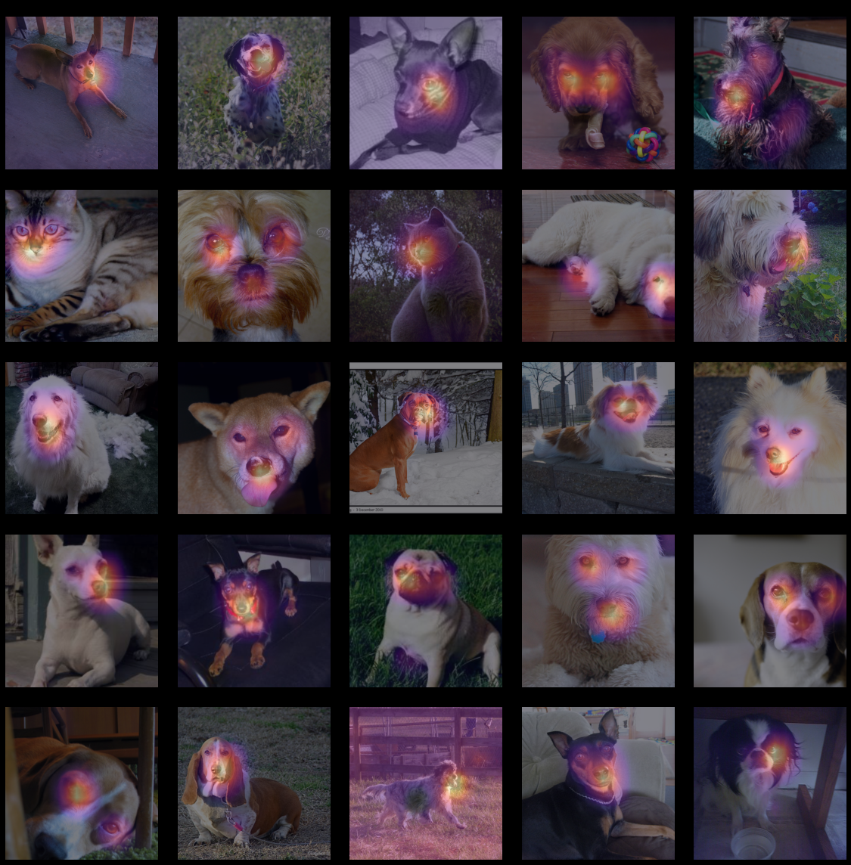
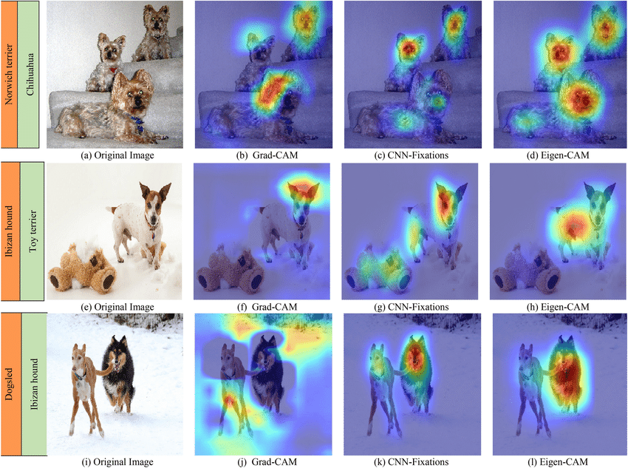
04
Additional Analysis Technique (CAM)
SEMINAR

Slide 13
Q&A
Thank you

